Slide 1

CodeScore
Allison Pearce, Spencer Lee,
Tanvir Ahmed, Will McDermid
Advisor: Chris Murphy

Slide 2
Outline
Introduction
Motivation
Background
High-Level Approach
System Details
Technical Challenges
Progress
Results
Next Steps

Slide 3
Introduction
CodeScore: an automated tool for measuring internal software quality by detecting code smells.
Focus: understandability and maintainability
Notes:
Uses code smells
Reports results as a single metric
Focuses on understandability and maintainability

Slide 4

Introduction
Code Smell: An easily recognized design weakness indicative of more significant problems
Examples:
Duplicated code
Inconsistent or confusing names
“Feature envy” – classes that make extensive use of members of other classes
Notes:
feature envy - one class using always using methods/variables in another class

Slide 5

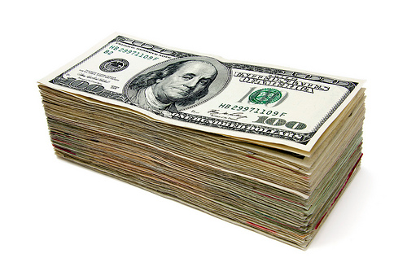

Motivation
Recruiting engineers is expensive
Rove (small company): $10,000
Google: $50,000 - $100,000
Time cost
Opportunity cost

Slide 6
Use Cases
Recruiting
Grading
- Internal quality underemphasized in classroom
Personal Evaluation
- No popular tools exist

Slide 7
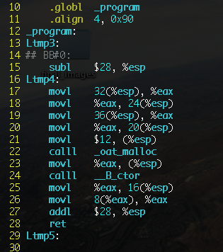
Background
Methodologies for code analysis
Parse code into manageable units
Control Structures
Tokens
Assembly Instructions
Objects

Slide 8



Background
Static code analysis tools
CodeSonar
Klocwork Insight
FingBugs
Yasca

Slide 9
Background
JOCS – Judgment of Code Style
2012/2013 CIS Senior Design Project
Attempt to mimic manual grading of code style
Line length
Consistency
Modularity
Utilizes a machine learning algorithm to compute a single score from the features

Slide 10
High-Level Approach
Code Scoring Module (EC2)
Code Sample
Worker Thread Pool
User
Code
Preferences
Detection Results
Feedback
Score
Detectors
Notes:
I swear this is crooked. Ima fix it.

Slide 11
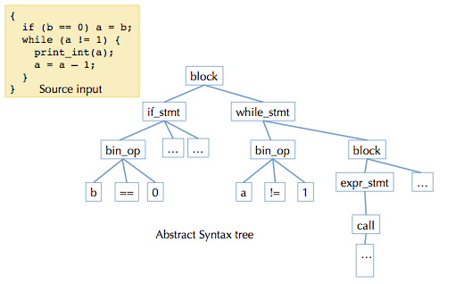
System Details
Parse Java source files using Java Abstract Syntax Tree API

Slide 12
System Details
Components:
Main driver/thread pool
Code smell detectors
Basic NLP library
Score: weighted average of detection results
Later: tune equation based on preferences
Process using Amazon Web Services EC2

Slide 13
Evaluation Criteria
Accuracy of code smell detection
Precision and recall
Comparison with human analysis
TP = # true positives
FN = # false negatives
FP = # false positives

Slide 14
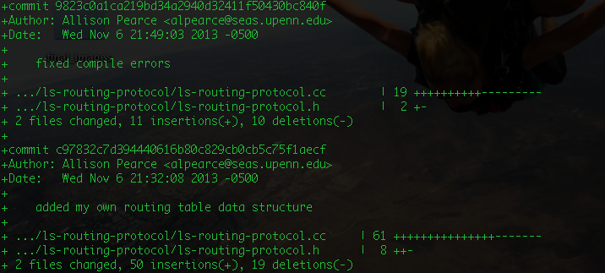
Technical Challenges
Objectively measure code quality
Allow customized analysis
Use revision history for code smell detection
Notes:
code quality inherently subjective
example: some people like camel case, some like underscores
need to make a system where either is okay, as long as it’s consistent
verify that our metrics reflect actual concerns with user studies

Slide 15
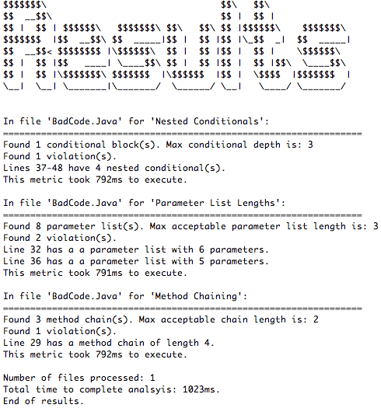
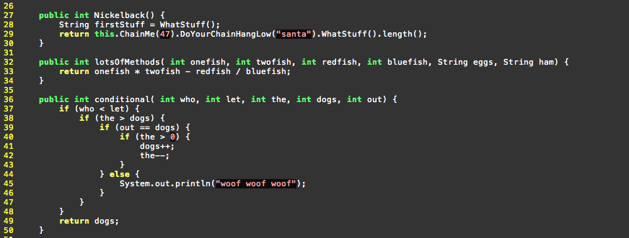
Progress

Slide 16
Next Steps
More detectors
Duplicated code
Naming conventions
Class relationships
Revision history
Scoring algorithm
User studies

Slide 17
References
http://www.quora.com/Engineering-Recruiting/What-is-the-average-cost-of-recruiting-an-engineer-in-Silicon-Valley
http://tech.fortune.cnn.com/2012/02/24/google-recruiting/
http://www.slideshare.net/eremedia/college-recruiting-on-a-shoestring-budget

Slide 18
Any Questions?

